Slide 1
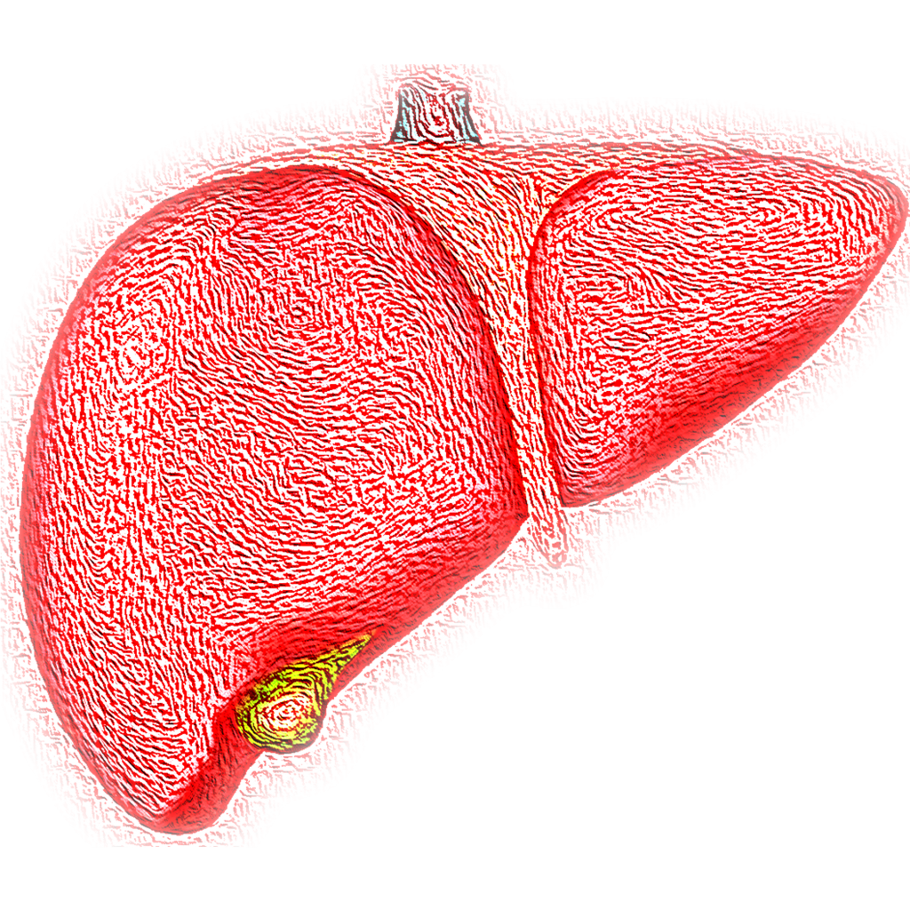
May 2022
Human liver RNA data analysis
Liron Gershuny
Danny Ben-Zvi Lab

Slide 2
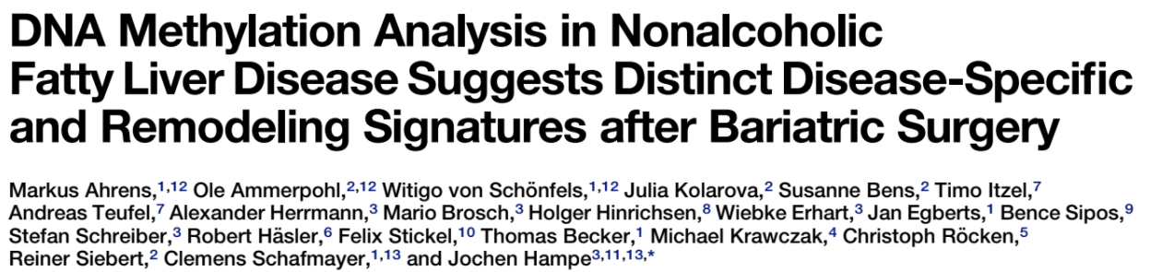
Series GSE48452
Aug 08 ,2013
Human liver biopsy of different phases from control to NASH
73 samples of human liver grouped into:
C (control=14)
H (healthy obese=27)
S (steatosis=14)
N (nash=18)

Slide 3
Filtering the data according to bariatric surgery
liver, C, A1359-05 | liver, N, A1359-06 | liver, H, A1359-07
GSM1178974 | GSM1178975 | GSM1178976
Control | Nash | Healthy obese
Homo sapiens | Homo sapiens | Homo sapiens
tissue type: liver biopsy | tissue type: liver biopsy | tissue type: liver biopsy
group: Control | group: Nash | group: Healthy obese
fat: 2 | fat: 80 | fat: 0
inflammation: 0 | inflammation: 1 | inflammation: 0
Sex: male | Sex: male | Sex: female
age: 80 | age: 49.00555556 | age: 44
bmi: 25.8 | bmi: 25.61728395 | bmi: 36.1
nas: 0 | nas: 4 | nas: 0
fibrosis: 0 | fibrosis: 1 | fibrosis: 1
lar: 0 | lar: 0.159091628 | lar: NA
delta lar: NA | delta lar: NA | delta lar: NA
delta leptin: NA | delta leptin: NA | delta leptin: NA
leptin: 0 | leptin: 0.901124 | leptin: NA
adiponectin: 26.372 | adiponectin: 5.664182401 | adiponectin: NA
delta adipo: NA | delta adipo: NA | delta adipo: NA
Control | 12
Healthy Obese | 16
Steatosis | 9
Nash | 17
Total | 54

Slide 4
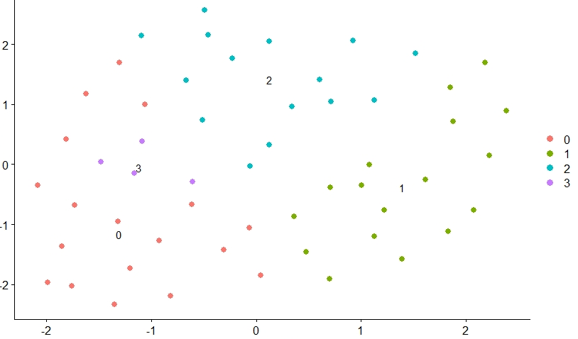
Clustering using k-nearest neighbors algorithm (k=5, 10, 20) into 4 groups

Slide 5
Filtering the data – Control vs Nash (before bariatric surgery only)
liver, C, A1359-05 | liver, N, A1359-06
GSM1178974 | GSM1178975
Control | Nash
Homo sapiens | Homo sapiens
tissue type: liver biopsy | tissue type: liver biopsy
group: Control | group: Nash
fat: 2 | fat: 80
inflammation: 0 | inflammation: 1
Sex: male | Sex: male
age: 80 | age: 49.00555556
bmi: 25.8 | bmi: 25.61728395
nas: 0 | nas: 4
fibrosis: 0 | fibrosis: 1
lar: 0 | lar: 0.159091628
delta lar: NA | delta lar: NA
delta leptin: NA | delta leptin: NA
leptin: 0 | leptin: 0.901124
adiponectin: 26.372 | adiponectin: 5.664182401
delta adipo: NA | delta adipo: NA
Control | 12
Nash | 17
Total | 29

Slide 6
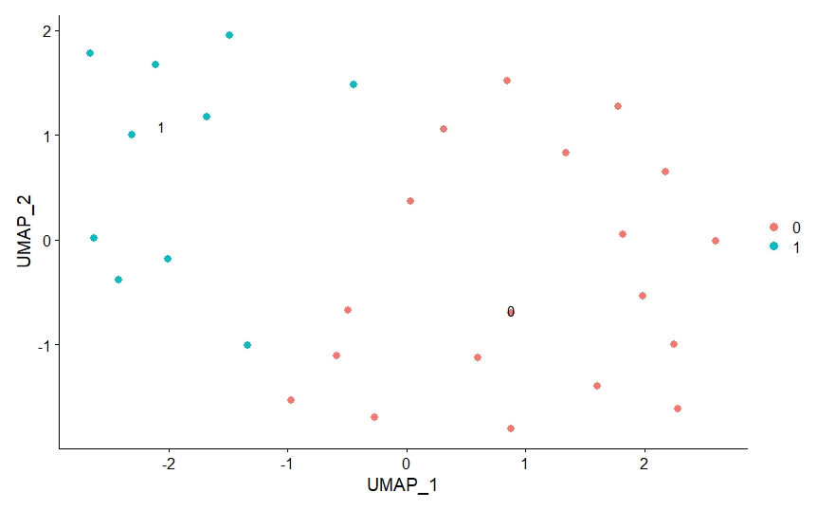
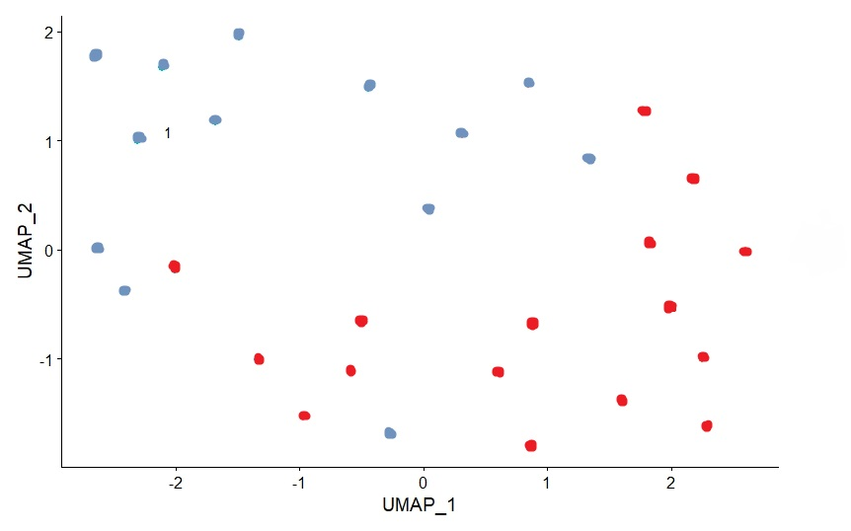
Clustering using k-nearest neighbors algorithm (k=10) into 2 groups
Control | Nash
Original clustering
According to data
10 most highly variable genes expression levels
GSTT1, GSTM1, FOS, CYP7A1, EGR1, PLA2G2A, IGFBP1, XPNPEP2, FOSB, GSTA2

Slide 7
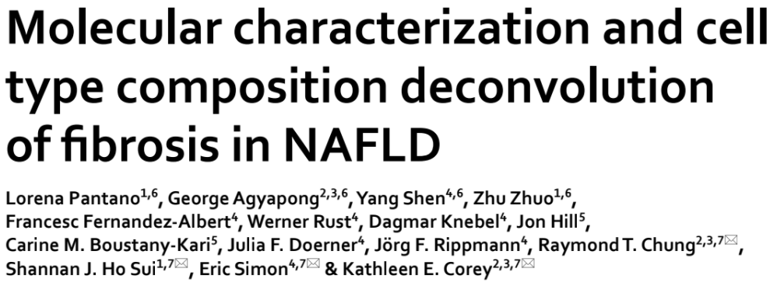
Series GSE162694
Jun 11 ,2021
mRNA-sequencing of 143 NASH patients of various fibrosis stages

Slide 8
A glimpse of the data
Title | nash1_F0 548nash1 | nash10_F1 548nash10 | nash100_N 548nash100 | nash101_F3 548nash101
geo_accession | GSM4957321 | GSM4957322 | GSM4957323 | GSM4957324
source_name_ch1 | Liver biopsy | Liver biopsy | Liver biopsy | Liver biopsy
organism_ch1 | Homo sapiens | Homo sapiens | Homo sapiens | Homo sapiens
Tissue | tissue: Liver | tissue: Liver | tissue: Liver | tissue: Liver
Age | age: 36 | age: 55 | age: 25 | age: 46
Sex | Sex: Male | Sex: Female | Sex: Female | Sex: Female
Fibrosis_stage | fibrosis stage: 0 | fibrosis stage: 1 | fibrosis stage: normal liver histology | fibrosis stage: 3
Nas_score | nas score: 3 | nas score: 3 | nas score: 0 | nas score: 7
143 samples of human liver varied by:
normal liver histology = 31
fibrosis stage: 0 = 35
fibrosis stage: 1 = 30
fibrosis stage: 2 = 27
fibrosis stage: 3 = 8
fibrosis stage: 4 = 12
nas score: 0 = 32
nas score: 1 = 12
nas score: 2 = 9
nas score: 3 = 11
nas score: 4 = 13
nas score: 5 = 19
nas score: 6 = 12
nas score: 7 = 9

Slide 9
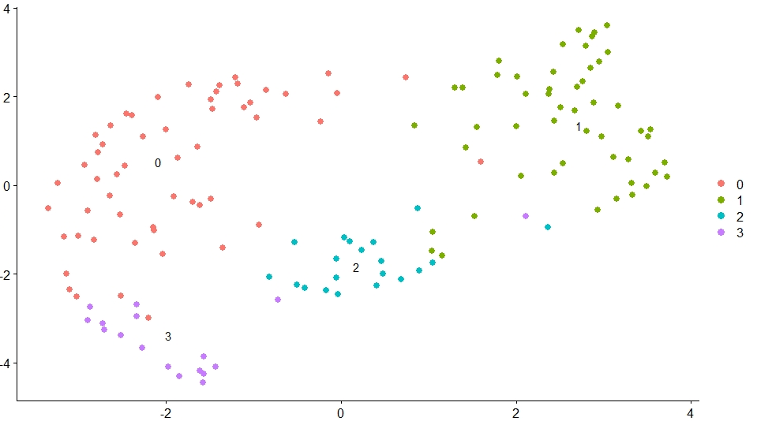
Clustering using k-nearest neighbors algorithm (k=20) into 4 groups

Slide 10
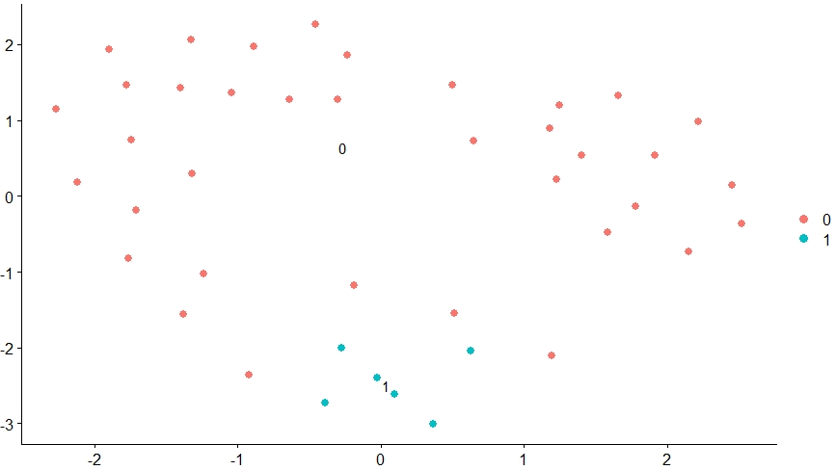
Filtering the data according to fibrosis stage –
normal liver histology vs fibrosis stage: 4
normal liver histology = 31
fibrosis stage: 4 = 12
Clustering using k-nearest neighbors algorithm (k=20) into 2 groups

Slide 11
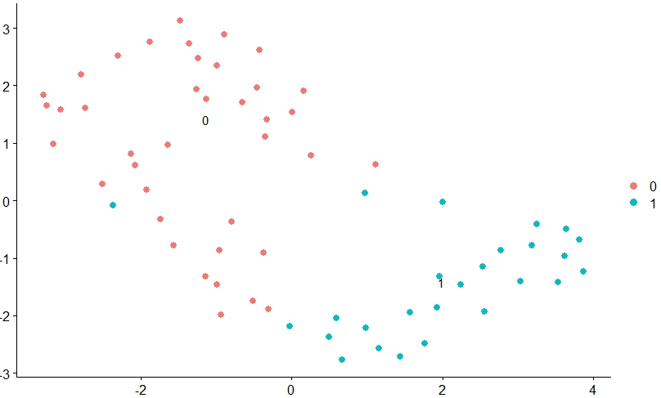
Filtering the data according to Nas score–
0, 1 score vs 6, 7 score
nas score: 0 = 32
nas score: 1 = 12
nas score: 6 = 12
nas score: 7 = 9
Clustering using k-nearest neighbors algorithm (k=10) into 2 groups

Slide 12
Conclusions so far..
First dataset grouped according to fatty liver stages
Second dataset grouped according to fibrosis stages
First dataset is a microarray vs RNA-seq at the second dataset
First dataset shows methylation properties other than gene expression
Second dataset use deconvolution other than transcriptome signature
Self-clusterization of the data is different from that of the pathology
EGR1 and FOS found as highly variable for the first dataset
TP53 found as highly variable for the second dataset
{

Slide 13
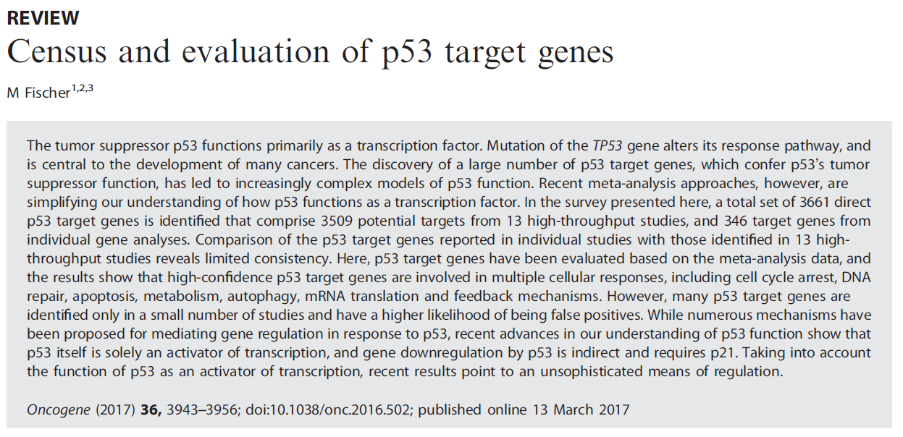
P53 target genes
March 13, 2017

Slide 14
P53 target genes
Ensembl ID | Gene Symbol | sum direct regulation score (-16..0..16) | sum direct target (0..16) | Literature (Table S1) | Wei 2006 5-FU HCT116 | Smeenk 2011 Actinomycin D U2OS | Smeenk 2011 etoposide U2OS | Nikulenkov 2012 Nutlin-3a MCF-7 | Menendez 2013 Nutlin-3a U2OS | Menendez 2013 doxorubicin U2OS | Schlereth 2013 p53 SAOS-2
ENSG00000124762 | CDKN1A | 17 | 17 | up | up | up | up | up | up | up | up
ENSG00000048392 | RRM2B | 17 | 17 | up | up | up | up | up | up | up | up
ENSG00000135679 | MDM2 | 16 | 16 | up | --- | up | up | up | up | up | up
ENSG00000100647 | SUSD6 | 15 | 15 | up | --- | up | up | up | up | up | up
ENSG00000130513 | GDF15 | 14 | 15 | up/down | --- | up | up | up | up | up | up
ENSG00000159388 | BTG2 | 14 | 14 | up | --- | up | up | up | up | up | up
ENSG00000134574 | DDB2 | 14 | 14 | up | up | up | up | up | --- | up | up
ENSG00000116717 | GADD45A | 14 | 14 | up | up | up | --- | up | up | up | up
ENSG00000060237 | WNK1 | -3 | 3 | --- | --- | down | --- | down | --- | --- | ---
ENSG00000145349 | CAMK2D | -4 | 4 | --- | --- | down | down | --- | --- | --- | ---
ENSG00000120254 | MTHFD1L | -4 | 4 | --- | down | down | --- | down | --- | --- | ---
ENSG00000169398 | PTK2 | -4 | 4 | down | down | down | --- | --- | --- | --- | ---
ENSG00000133119 | RFC3 | -4 | 4 | --- | --- | down | --- | down | --- | --- | ---
ENSG00000004864 | SLC25A13 | -4 | 4 | --- | --- | down | --- | --- | --- | --- | ---
ENSG00000115464 | USP34 | -4 | 4 | --- | down | down | down | --- | --- | --- | ---
ENSG00000164338 | UTP15 | -4 | 4 | --- | --- | --- | --- | --- | --- | --- | down
ENSG00000170312 | CDK1 | -5 | 5 | down | --- | down | --- | --- | --- | --- | ---
ENSG00000010292 | NCAPD2 | -5 | 5 | --- | down | --- | --- | --- | --- | down | ---
ENSG00000112081 | SRSF3 | -5 | 5 | --- | --- | down | down | --- | --- | --- | ---
3,660 target genes

Slide 15
Series GSE48452
Aug 08 ,2013
Human liver biopsy of different phases from control to NASH
73 samples of human liver grouped into:
C (control=14)
H (healthy obese=27)
S (steatosis=14)
N (nash=18)

Slide 16
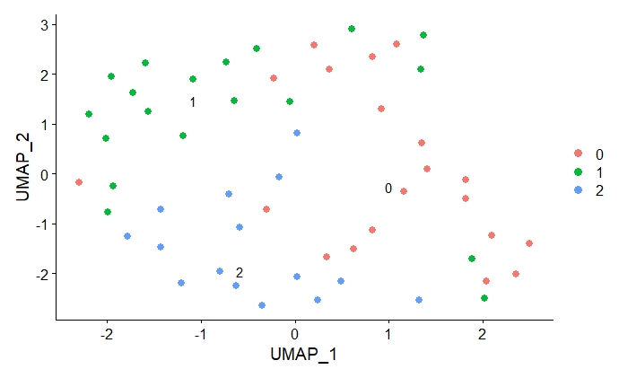
Clustering using k-nearest neighbors algorithm (k=20) into 3 groups
Self-clusterization of the data is different from that of the pathology

Slide 17
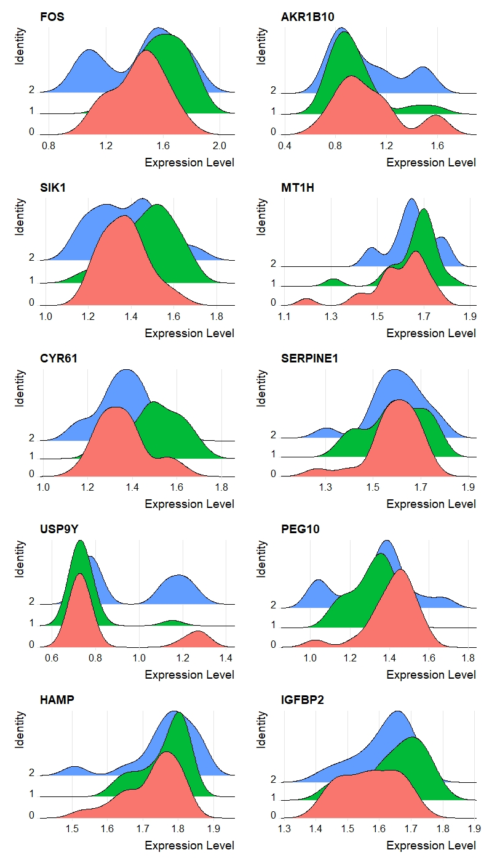
Ridge plot of the 10 most highly variable genes according to clusters

Slide 18
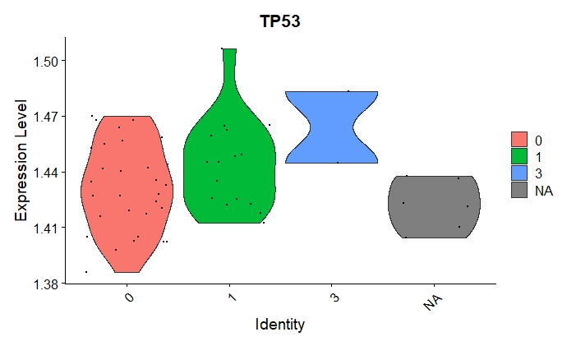
P53 expression levels according to fibrosis stage

Slide 19
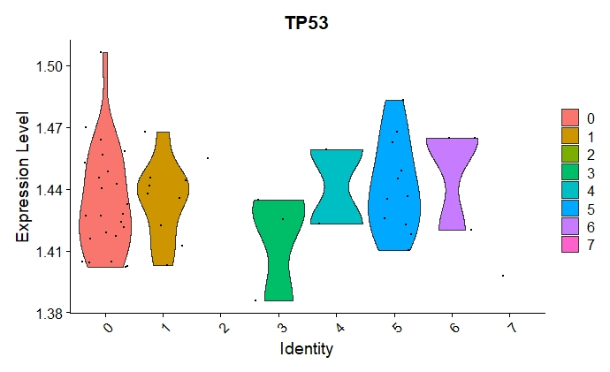
P53 expression levels according to nas score

Slide 20
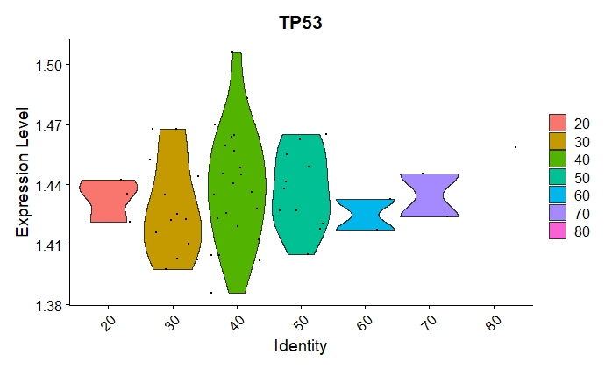
P53 expression levels according to age

Slide 21
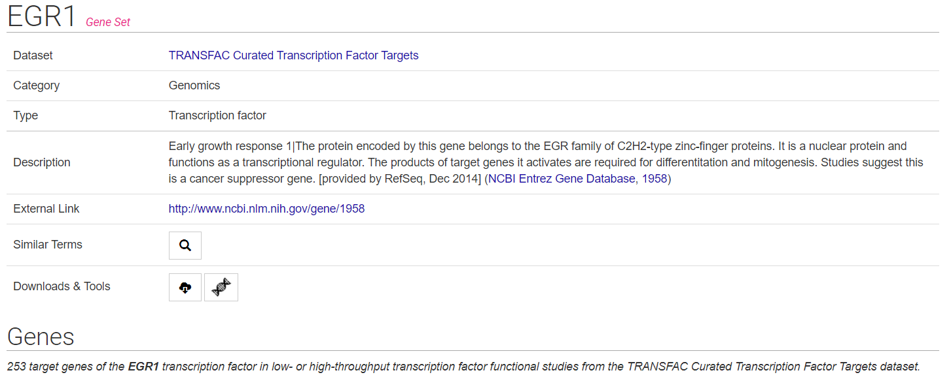
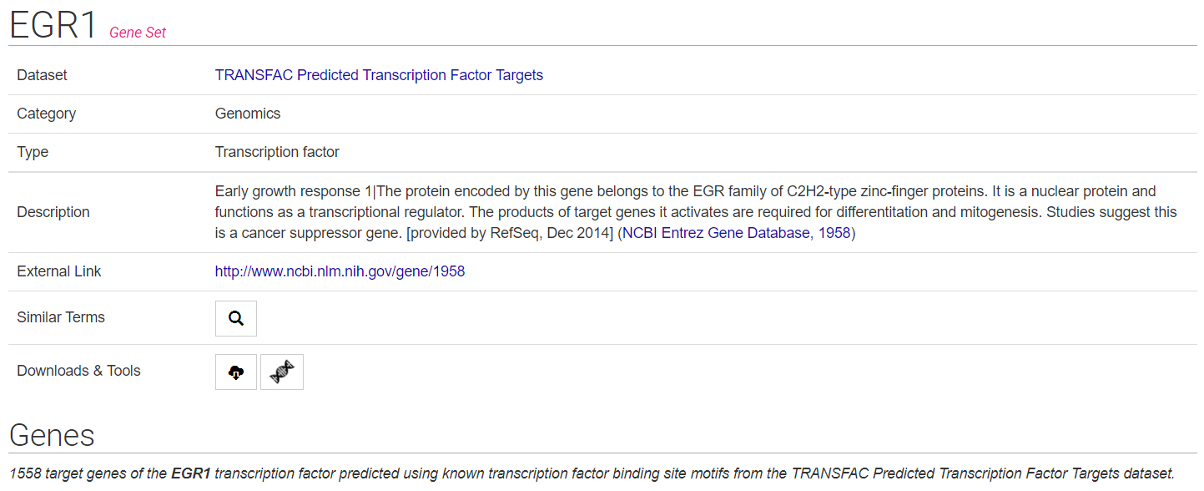
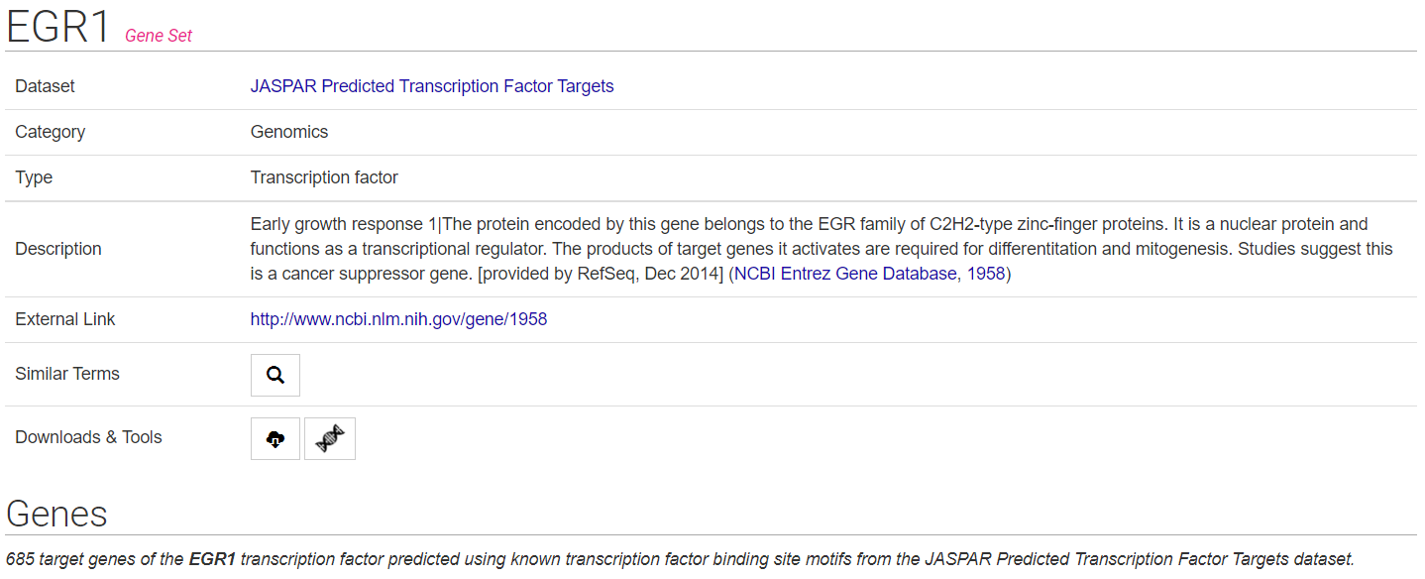
EGR1 target genes
Harmonizome website
2,234 target genes

Slide 22
Series GSE48452
Aug 08 ,2013
Human liver biopsy of different phases from control to NASH
73 samples of human liver grouped into:
C (control=14)
H (healthy obese=27)
S (steatosis=14)
N (nash=18)

Slide 23
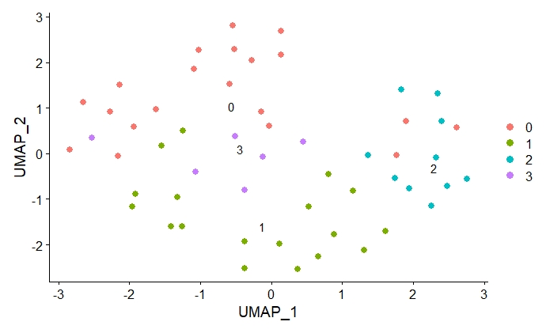
Clustering using k-nearest neighbors algorithm (k=10) into 4 groups
Self-clusterization of the data is different from that of the pathology

Slide 24
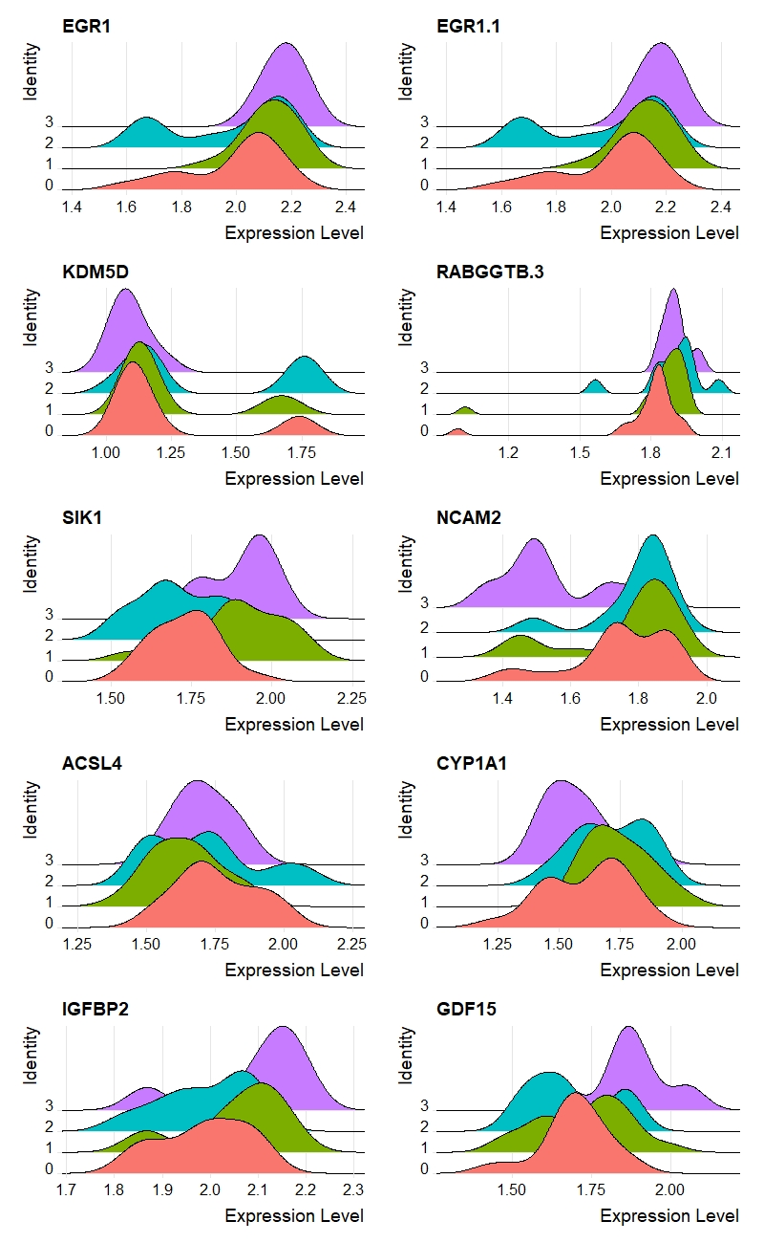
Ridge plot of the 10 most highly variable genes according to clusters

Slide 25
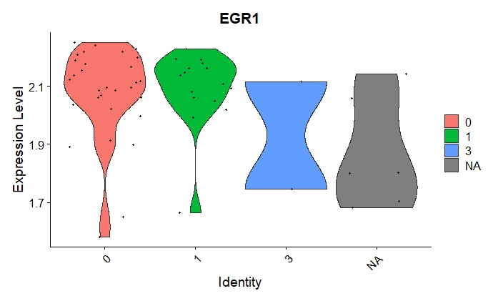
EGR1 expression levels according to fibrosis stage

Slide 26
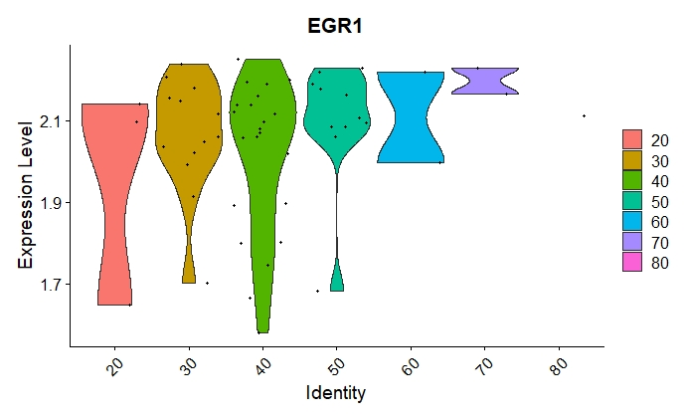
EGR1 expression levels according to age

Slide 27
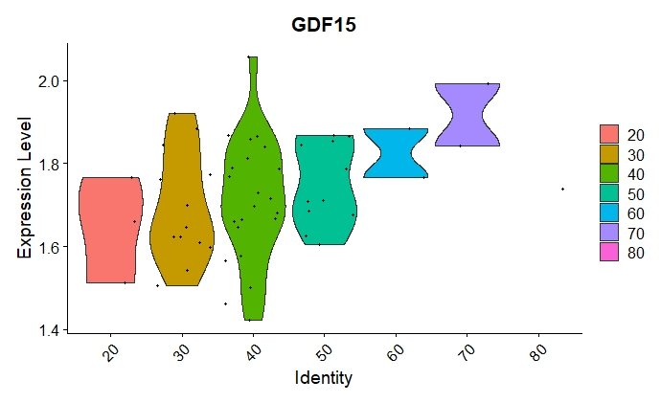
GDF15 expression levels according to age

Slide 28
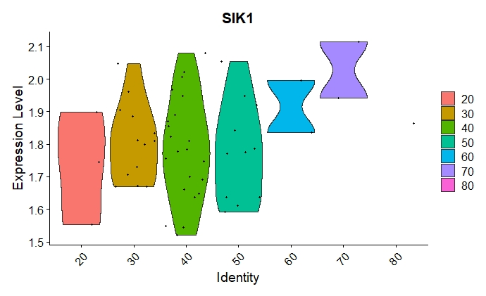
SIK1 expression levels according to age

Slide 29
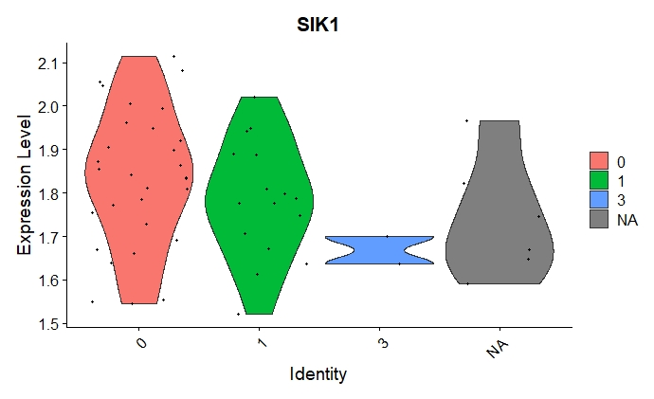
SIK1 expression levels according to fibrosis stage

Slide 30
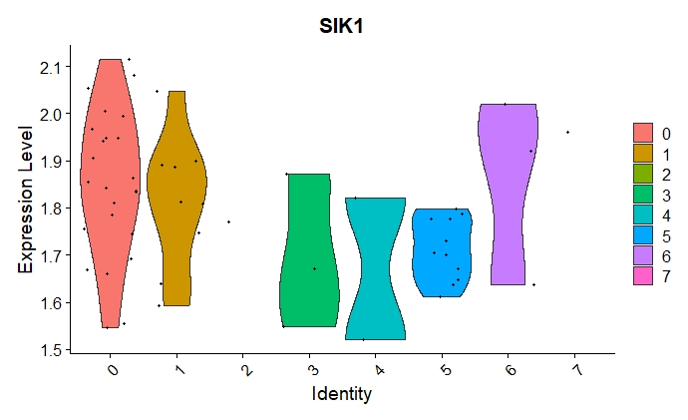
SIK1 expression levels according to nas score

Slide 31
Series GSE162694
Jun 11 ,2021
mRNA-sequencing of 143 NASH patients of various fibrosis stages

Slide 32
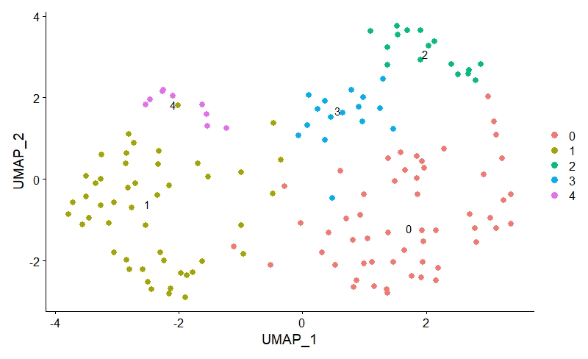
Clustering using k-nearest neighbors algorithm (k=10) into 5 groups
Self-clusterization of the data is different from that of the pathology

Slide 33
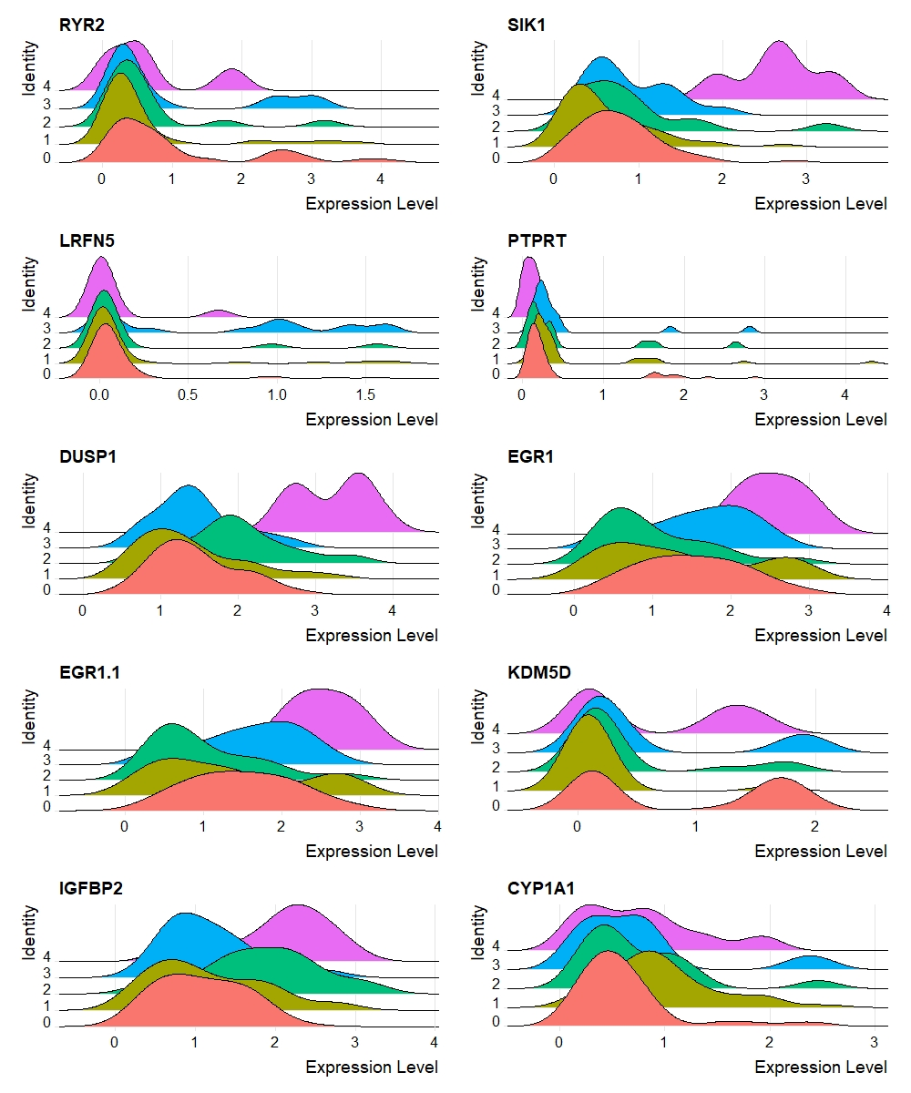
Ridge plot of the 10 most highly variable genes according to clusters
Half of the most highly variablt genes are common for the two datasets! EGR1, SIK1, KDM5D, IGFBP2, CYP1A1

Slide 34
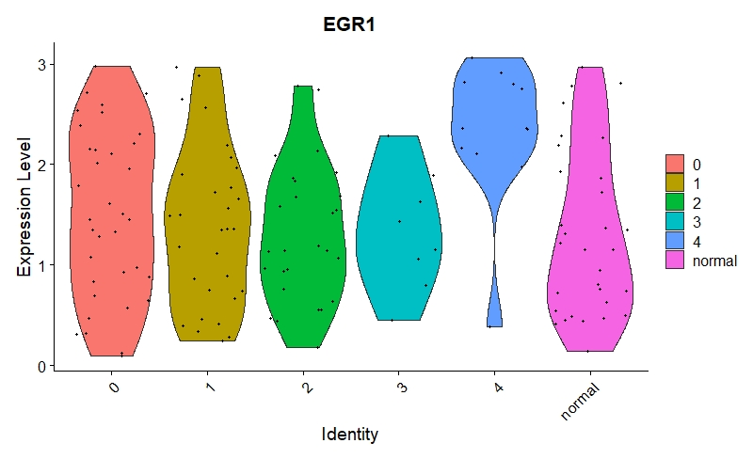
EGR1 expression levels according to fibrosis stage
A trend opposite to the one we saw in the previous dataset!

Slide 35
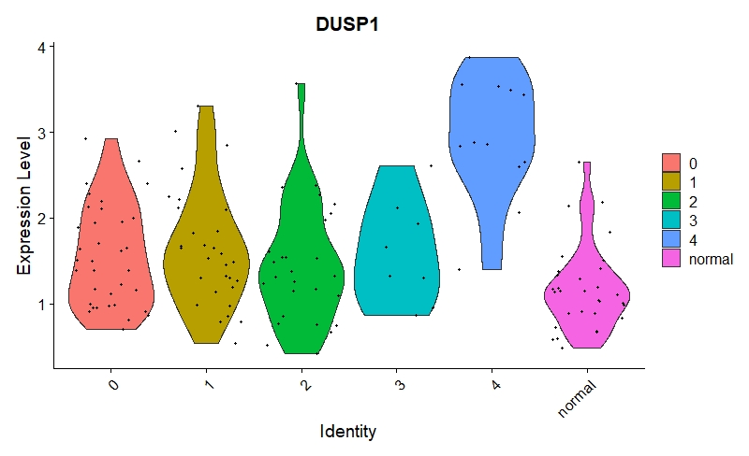
DUSP1 expression levels according to fibrosis stage

Slide 36
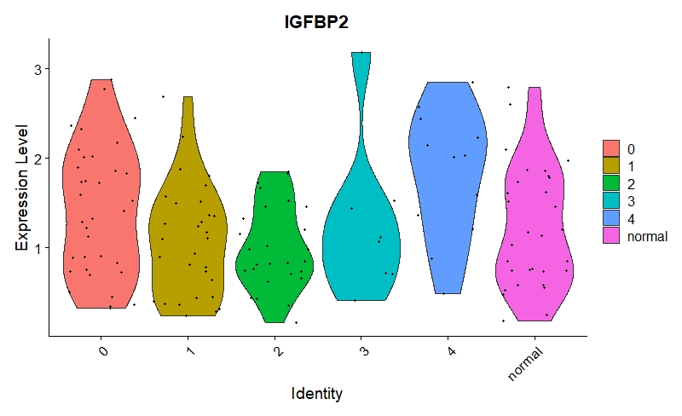
IGFBP2 expression levels according to fibrosis stage

Slide 37
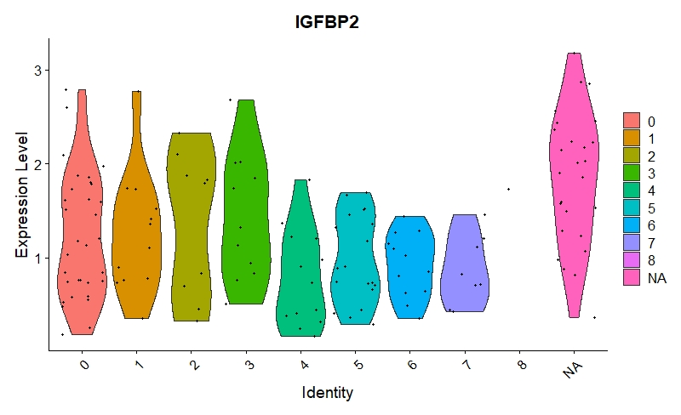
IGFBP2 expression levels according to nas score

Slide 38
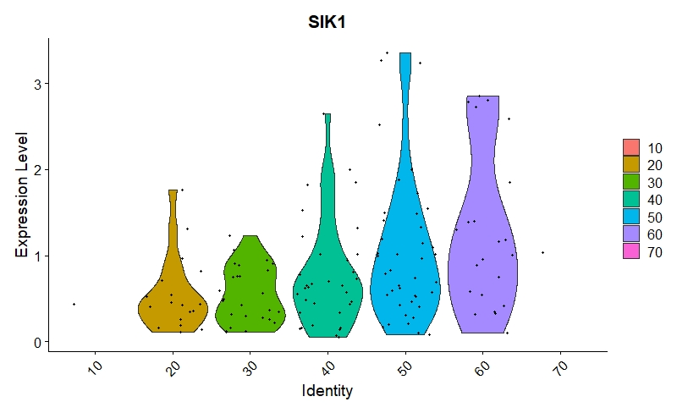
SIK1 expression levels according to age
A trend similar to the one we saw in the previous dataset!

Slide 39
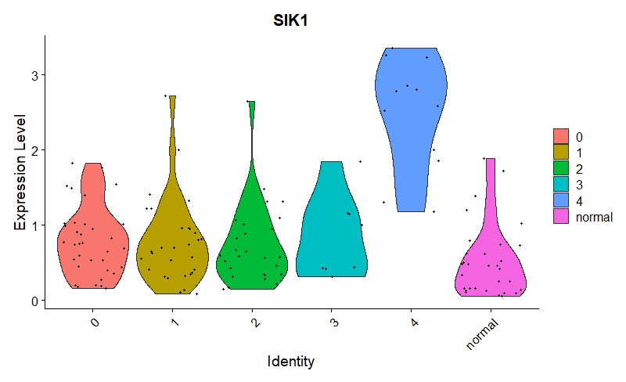
SIK1 expression levels according to fibrosis stage
A trend opposite to the one we saw in the previous dataset!

Slide 40
Conclusions
First dataset is a microarray vs RNA-seq at the second dataset
Self-clusterization of the data is different from that of the pathology
P53 target genes analysis doesn’t show a significant trend for the second dataset
EGR1 target genes analysis of the two datasets show:
Common highly variable genes
Similar and opposite trends of EGR1 and SIK1 genes

